Slide 1
Test Driven Development
Anil Sakala

Slide 2
Agenda
Conventional way of developing software – Requirements , Code and Test
Disadvantages with conventional approach
Being test driven – TDD & ATDD
Example using TDD
Other topics

Slide 3
Conventional way of developing software - Disadvantages
Conventional way – Requirements , Freeze Code and Test
Disadvantages :
Quality is a concern :
Defects
Maintainenece (No safety net)
Solution : TDD
Changing requirements – Changing business rules
Better way of communicating between developers and testers
Solution : ATDD
Above problems can be overcome very easily by being test driven

Slide 4
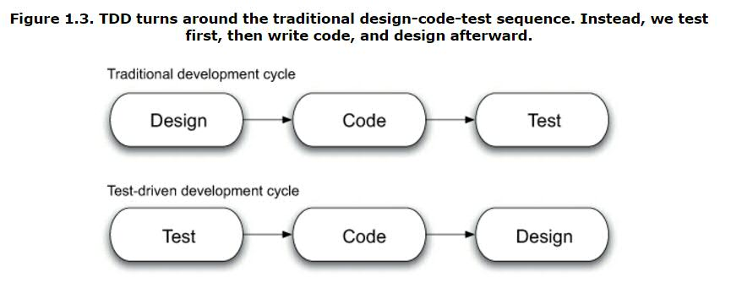
Being test driven
Test Driven = TDD + ATDD
TDD :
Lifecycle of TDD – Test , Code , Refactor
Only ever write a code to fix a failing test
Above problems can be overcome very easily by being test driven

Slide 5
TDD
Tools that help you writing this kind of code – Junit , TestNG , Mocking Frameworks
Advantages :
Every object will have test object . This works like safety net
Thorough testing and immediate defects
Easy maintainenece
Example : Check if a given String is palindrome or not

Slide 6
ATDD
Conventional – Feature as requirement document , Code , Test , Customer acceptance test
ATDD : Convert the requirement document to a set of acceptable tests and then build your system against these tests
There are different tools available for this – Cucumber and Fit tool.
How cucumber helps you in building
Living document
Reduces gap between developers and BA’s
Trigger your test suite – Starts validating document against system
Summary :
Write AT tests , Run Them , Build system to satisfy these tests

Slide 7
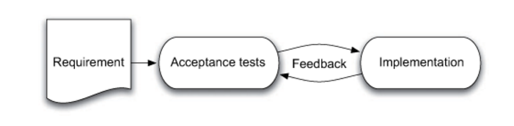
ATDD

Slide 8
Conclusion
TDD and ATDD improve the quality of work
References
Test Driven: Practical TDD and Acceptance TDD for Java Developers

